Slide 1
HML to FHIR Conversion
Andrew S. Brown, Ph.D.

Slide 2
HML
Histoimmunogenetics Markup Language
Developed / Extended by NMDP as a format to transmit genetic typing information obtained through NGS
Allows for reporting of highly variable genes such as Human Leukocyte Antigen (HLA) with nominal resolution and sequence quality information
HML is XML based and utilizes XSD schema definitions
Schemas can be found at: http://schemas.nmdp.org/
Current version: 1.01

Slide 3
FHIR
Fast Healthcare Interoperability Resources
Based on Health Level 7 (HL7) standards
Resource based information exchange
Well suited for exchange of HL7-type observations
Maintains high resolution of genetic typing data similar to HML

Slide 4
Why FHIR?
To support interoperability and exchange of genetic information amongst labs, clinical entities, and research organizations, FHIR / HL7 in a uniformed approach
Clinical genomic data exchange
Promote standardization
Not a replacement for HML
Parallel format to support uniformed data format based on HL7 standards

Slide 5
Conversion Architecture
Resource Server:
service-hml-fhir-converter
(https://github.com/nmdp-bioinformatics/service-hml-fhir-converter)
External APIs (service-hml)
Client Application:
web-hml-fhir-converter
(https://github.com/nmdp-bioinformatics/web-hml-fhir-converter)
MongoDB

Slide 6
service-hml-fhir-converter
Springboot / Java (8) RESTful API
Contains traditional multilayered architecture, API (controller) -> Service -> Data Access
Conversion utilities are built into the Service layer
Communication with 3rd party and external APIs handled by Service layer

Slide 7
service-hml-fhir-converter
Data persistence is currently handled with MongoDB
Open source
Supports extremely fast read and write times
Support for Map-Reduce operations
Scales well with growing architectures
Should the need arise, MongoDB can be replaced with virtually any database that is desired
To support this, we have modelled HML format to a ‘Resource’ based object

Slide 8
service-hml-fhir-converter
Controllers (API) and Models are defined with Swagger
Developed a Python utility to auto-generate:
Controllers
Models
Services (CRUD)
Datalayer (CRUD)
Swagger specification files

Slide 9
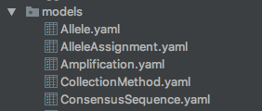
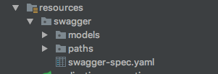
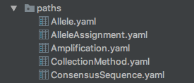
service-hml-fhir-converter
Auto-generation utility architecture
Uses template files for the majority of Java code creation
Separates models and controller definitions that are needed to compile the main swagger-spec.yaml file into individual resource files
Aids in the management of large APIs
Reduces file scanning and modification

Slide 10
service-hml-fhir-converter
Separation of org.nmdp.hmlfhirconverter from io.swagger
This project utilizes swagger-codegen to auto-generate Controllers, Models, and some routing declarations
Swagger modules are contained in target/generated-sources/swagger/src/gen/java/main/io.swagger/*
Controllers are stubbed out to return a NotFoundException
Developed a pattern that allows for the implementation of controllers to be separated from swagger-codegen, avoiding the overwriting of code on each generation

Slide 11
service-hml-fhir-converter
package: io.swagger
target/generated-sources/swagger/src/gen/java/main/io.swagger.api
package: org.nmdp.hmlfhirconverter
src/main/java/main/org.nmdp.hmlfhirconverter.controllers
@OverrideMethod
Method
NotFoundException
Implementation
Overwrite on swagger-codegen

Slide 12
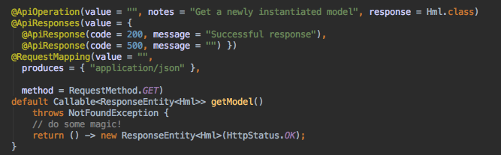
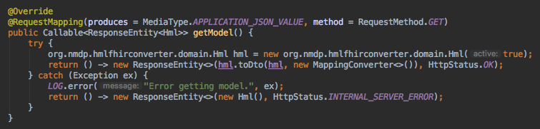
service-hml-fhir-converter
package: io.swagger
target/generated-sources/swagger/src/gen/java/main/io.swagger.api
package: org.nmdp.hmlfhirconverter
src/main/java/org.nmdp.hmlfhirconverter.controllers

Slide 13
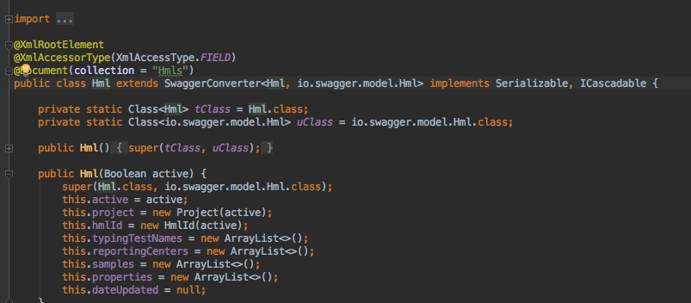
service-hml-fhir-converter
HML is modelled as a complex object with resources
Resources are persisted as collections in MongoDB
Each parent resource contains a separate collection with child resources in a cascading pattern
ICascadable interface

Slide 14
service-hml-fhir-converter

Slide 15
service-hml-fhir-converter
Saving a model implementing ICascadable causes all child resources (implementing ICascadable) to save in their respective collections
Sub-resources are consumed in various methods, procedures, design patterns that will be referred to later on in this presentation
There is a performance impact that directly correlates to the number of sub-resources implementing ICascadable

Slide 16
web-hml-fhir-converter
A client user interface to consume resources of service-hml-fhir-converter
Uses Angular 1.6.0 library, along with a variety of public / open source Javascript libraries
Grunt build
Grunt server

Slide 17
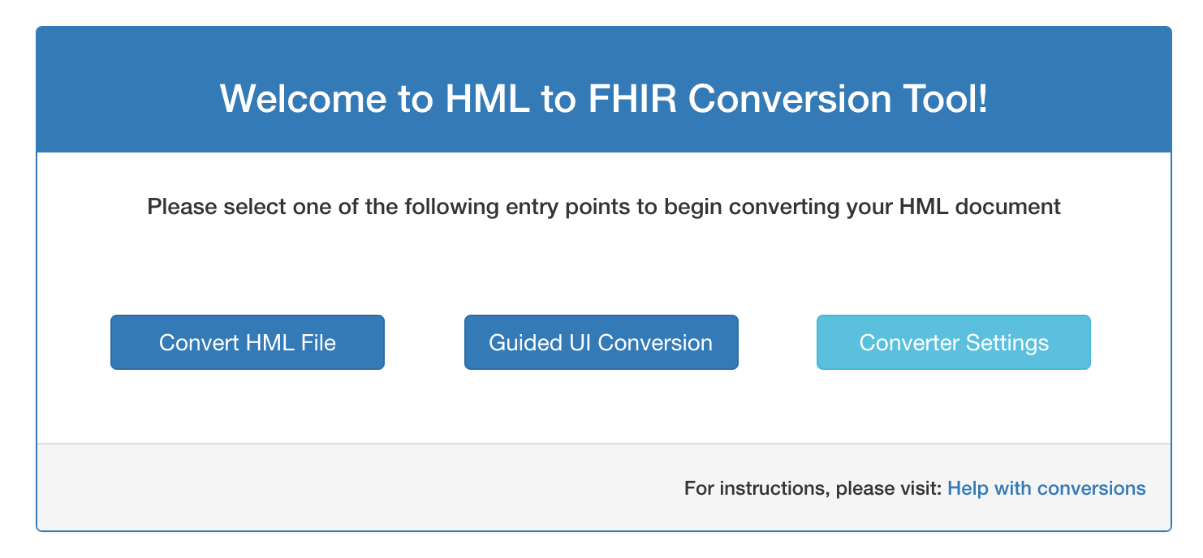
web-hml-fhir-converter
Ultimate goal is to support conversion of HML to FHIR / FHIR to HML
Ability to validate and implement MIRING standards / principals
Conversion to be accomplished via file uploads or user input

Slide 18
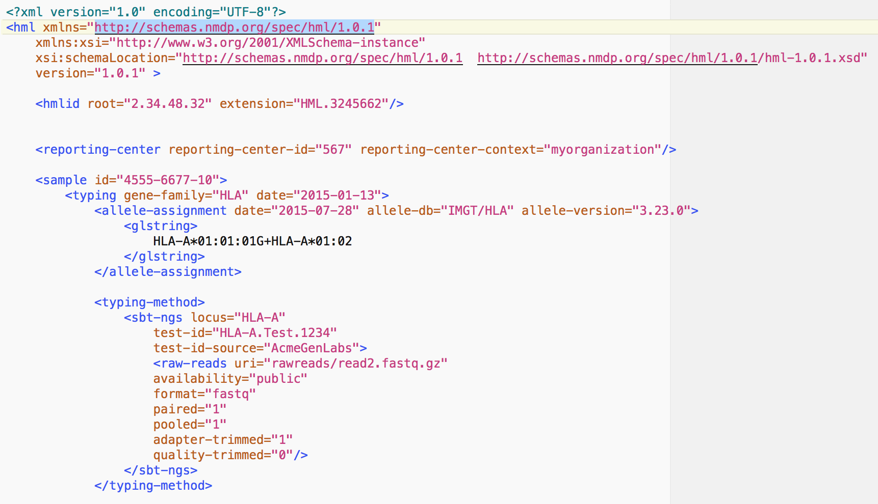
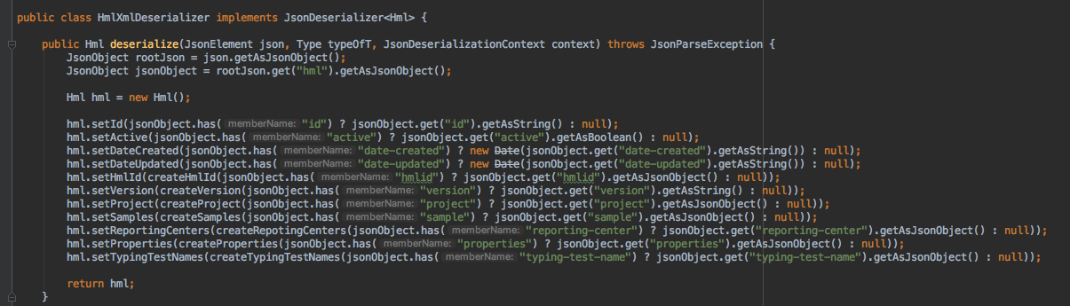
web-hml-fhir-converter
File upload involves the uploading of a HML message, converting to a Java object
Created a custom deserializer class that will support the transition of a standard HML message to a Java model

Slide 19

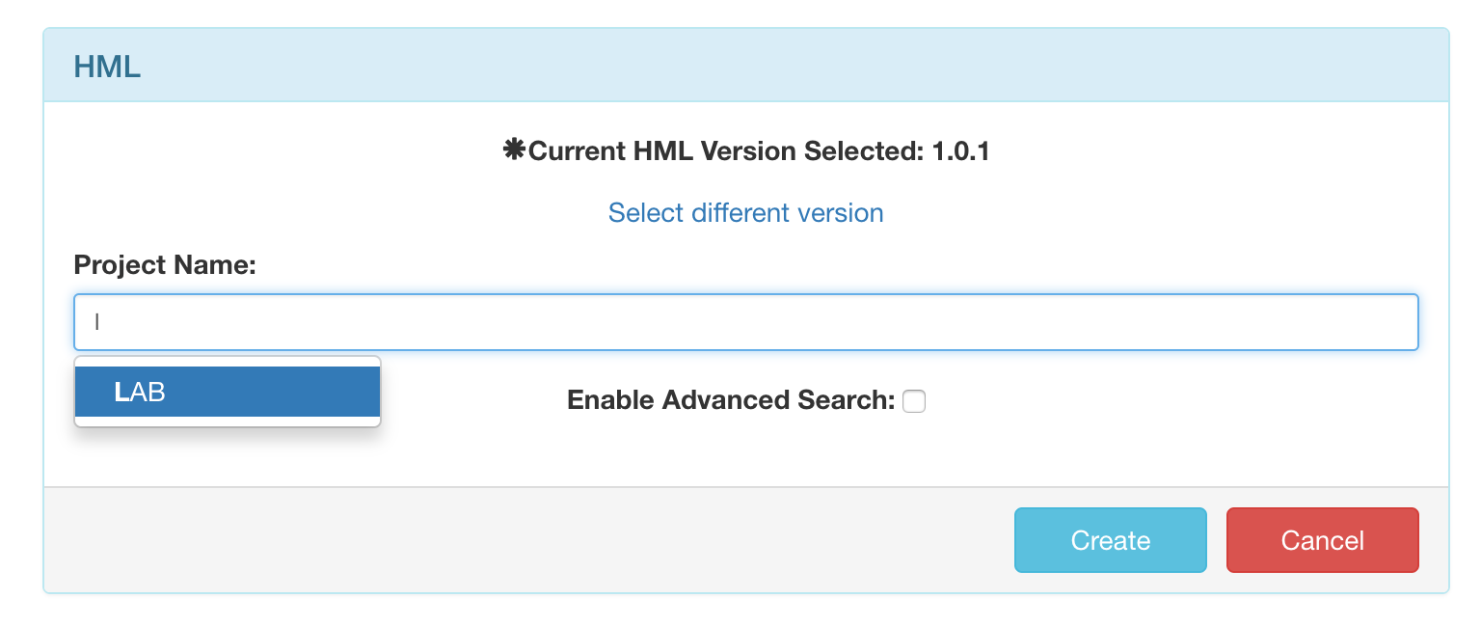
web-hml-fhir-converter
Guided UI conversion allows users to input data for their desired format by manually entering values
This is supported by the cascadable collections
To support accuracy of typing and speed of data entry, a typeahead input was created

Slide 20
web-hml-fhir-converter
The use of typeahead inputs reduces the amount of erroneously entered data
MongoDB’s speed and scalability supports the heavy use case of loading down the server with query requests from each keystroke

Slide 21
Conversion of HML to FHIR
Either method of input (file upload / manual) will ultimately result in the creation of a runtime java model
Java HML model is converted to a FHIR resource by mapping
The use of the Mapper (org.modelmapper) project allows for conversion of HML to FHIR models
Currently constructing map definitions to support the conversion of HML to FHIR (service-hml-fhir-converter)

Slide 22
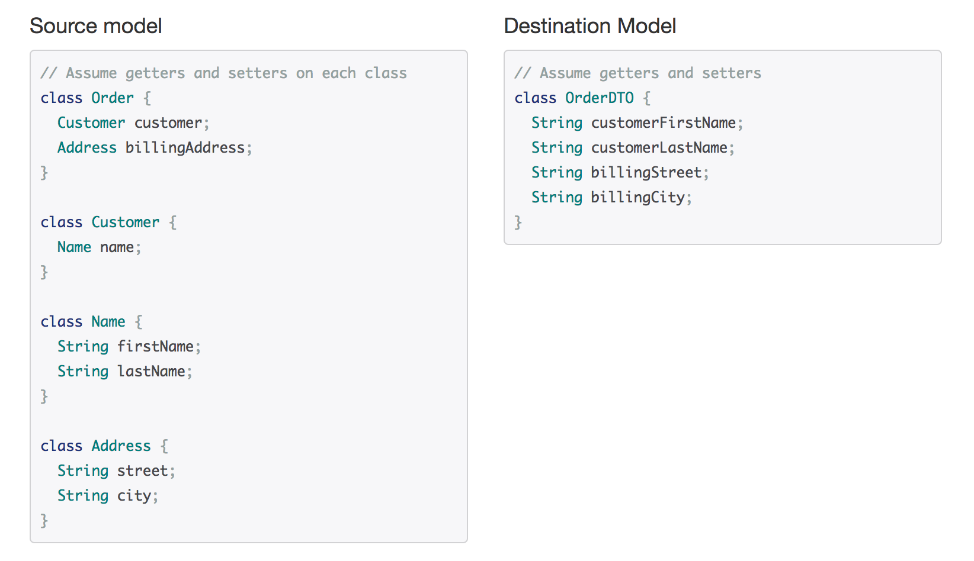
Conversion of HML to FHIR
Mapper classes make an intelligent attempt at mapping properties based on names and structure
This can be overridden via specific mapping definitions
Currently attempting various mapping definitions to correctly implement HML to FHIR conversion

Slide 23
Building / Running
To build web-hml-fhir-converter, please make sure all required dependencies specified in the documentation are already installed
Build the project by issuing ‘grunt’ from the command line / terminal at the root of the package
Serve the web application with ‘grunt serve’
This will open the browser at localhost:9000
https://github.com/nmdp-bioinformatics/web-hml-fhir-converter

Slide 24
Building / Running
To build service-hml-fhir-converter, please make sure all required dependencies specified in the documentation are already installed
Build the project by issuing ‘mvn clean install’ from the root directory of the project in the terminal or command line
Building will output a JAR file located in the /target directory
Run the server by issuing ’java –jar target/service-hml-fhir-converter-0.0.1-SNAPSHOT.jar’
https://github.com/nmdp-bioinformatics/service-hml-fhir-converter

Slide 25
QUESTIONS?
Contact:
Andrew Brown, PhD <abrown3@nmdp.org>

Slide 26
Acknowledgements
Bob Milius, Ph.D. (NMDP), Principal Investigator
Martin Maiers (NMDP), Directory Bioinformatics
Jane Pollack (NMDP), Solutions Manager
Pradeep Bashyal (NMDP), Software Architect
Jason Brelsford (NMDP), Dev Ops
Enoch Kahn (University of Minnesota), Intern

